Slide 1
Lect.03 Time Varying Fields and Maxwell’s Equations
Prepared by
Dr. Eng. Sherif Hekal

Slide 2
Introduction
Important definitions
$$\overline{E}$$
Electric field intensity (V/m)
$$\overline{H}$$
Magnetic field intensity (A/m)
$$\overline{D}$$
Electric flux density (Coulomb/m²)
$$\overline{B}$$
Magnetic flux density (Weber/m²) or Tesla
$$\overline{D}= ε_{0}ε_{r}\overline{E}$$
$$\overline{B}= μ_{0}μ_{r}\overline{H}$$
$ε_{0}$ = Permittivity of free space
= 8.85x10⁻¹² Farad/m
$μ_{0}$ = Permeability of free space
= 4πx10⁻⁷ Henry/m
$ε_{r}$ = Relative Permittivity of media
$μ_{r}$ = Relative Permeability of media

Slide 3
Introduction
Time-Varying Fields
Stationary charges electrostatic fields
Steady currents magnetostatic fields
Time-varying currents electromagnetic fields
Only in a non-time-varying case can electric and magnetic fields be considered as independent of each other. In a time-varying (dynamic) case the two fields are interdependent. A changing magnetic field induces an electric field, and vice versa.

Slide 4
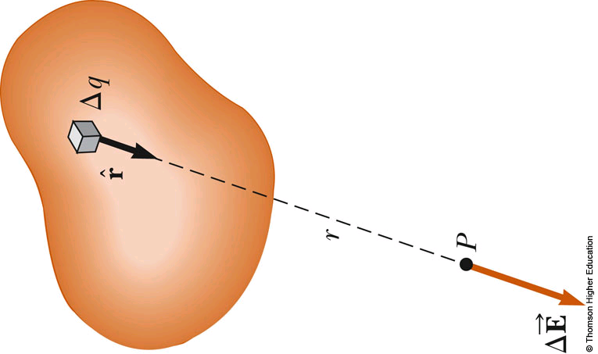
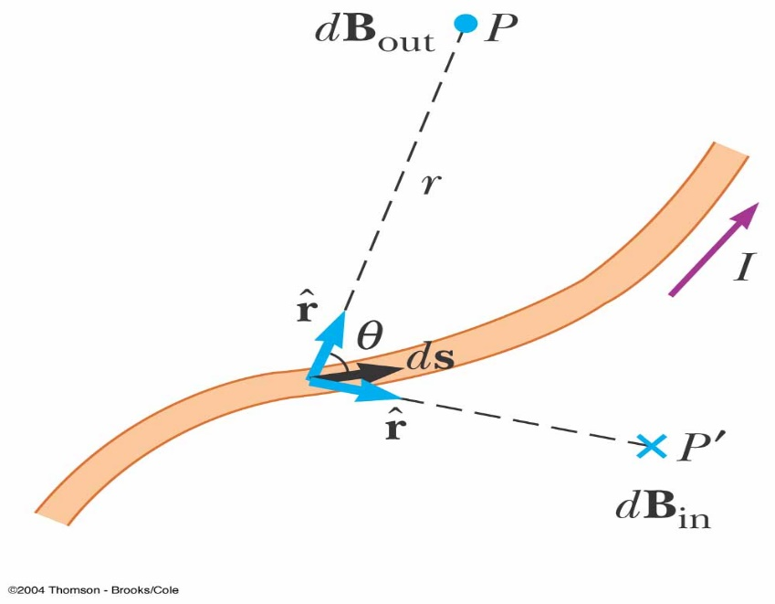
Sources of Electric field, magnetic field
Sources of Electric field, magnetic field
From Coulomb's Law, a point charge dq generates electric field distance away from the source:
From Biot-Savart's Law, a point current generates magnetic field distance away from the source:
Difference:
A current segment , not a point charge dq, hence a vector.
Cross product of two vectors, is determined by the right-hand rule.

Slide 5
Maxwell’s equations
Gauss Law for Electric Field
It states that The total electric flux passing through any closed surface is equal to the total charge enclosed by that surface.
(2.1)
(2.2)
Total charge enclosed
(2.3)
(2.4)

Slide 6
Maxwell’s equations
Using Divergence Theorem
(2.5)
Comparing the two volume integrals in (2.4) and (2.5)
(2.6)
This is the first Maxwell’s equation.
It states that the volume charge density is the same as the divergence of the electric flux density.

Slide 7
Maxwell’s equations
Gauss Law for Magnetic Field
The magnetic flux density B is related to the magnetic field intensity H
(2.7)
where µ_{o} is a constant and is known as the permeability of free space.
Its unit is Henry/meter (H/m) and has the value
H/m
The magnetic flux through a surface S is given by
(2.8)
where the magnetic flux Ф_{m} is in webers (Wb) and the magnetic flux density is in weber/ m² or Tesla.

Slide 8
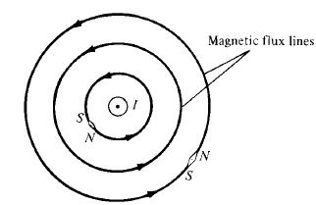
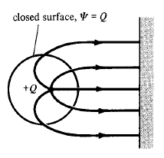
Maxwell’s equations
Magnetic flux lines due to a straight wire with current coming out of the page
Each magnetic flux line is closed with no beginning and no end and are also not crossing each other.
In an electrostatic field, the flux passing through a closed surface is the same as the charge enclosed.
Thus it is possible to have an isolated electric charge. Also the electric flux lines are not necessarily closed.

Slide 9
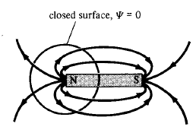
Maxwell’s equations
Magnetic flux lines are always close upon themselves,.
So it is not possible to have an isolated magnetic charges.
An isolated magnetic charge does not exist.
Thus the total flux through a closed surface in a magnetic field must be zero.
(2.9)
This equation is known as the law of conservation of magnetic flux or Gauss’s Law for Magnetostatic fields.

Slide 10
Maxwell’s equations
Applying Divergence theorem, we get
or
(2.10)
This is Maxwell’s second equation.
This equation suggests that magnetostatic fields have no source or sinks.
Also magnetic flux lines are always continuous.

Slide 11
Maxwell’s equations
Faraday’s law of induction
We have learned that a constant current induces magnetic field and a constant charge (or a voltage) makes an electric field. Similar phenomena happen when currents/voltages are changing in time.
The relation between the electric and magnetic field components is governed by the Faraday’s law…
$$V\left(t\right)=−\frac{dΦ_{m}(t)}{dt}$$
(2.11)
Lentz’s law
where $Φ_{m}(t)$ is the total time-varying magnetic flux passing through a surface.
Notes:
Lenz's Law
Lenz's law states that when an emf is generated by a change in magnetic flux according to Faraday's Law, the polarity of the induced emf is such, that it produces an current that's magnetic field opposes the change which produces it.

Slide 12
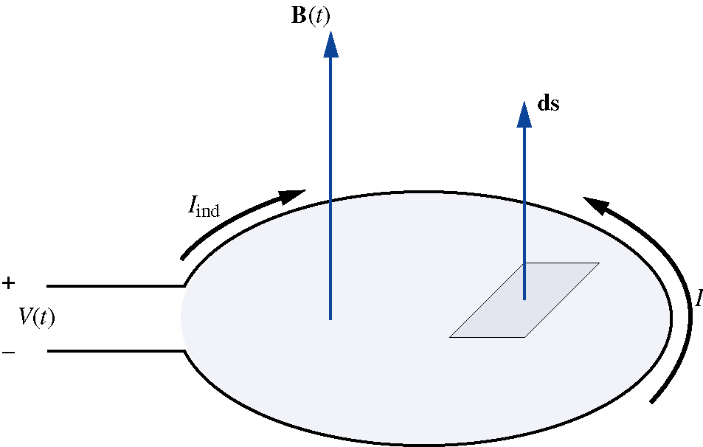
Maxwell’s equations
Faraday’s law of induction, cont’d
The terminals of the loop are separated by an infinitely small distance
Therefore, we consider an individual turn of a coil (inductor) as a closed loop.
At a glance: an electric current (an emf) is generated in a closed loop when any change in magnetic environment around the loop occurs (Faraday’s law). When an emf is generated by a change in magnetic flux according to Faraday's Law, the polarity of the induced emf is such that it produces a current whose magnetic field opposes the change which produces it. The induced magnetic field inside any loop of wire always acts to keep the magnetic flux in the loop constant.

Slide 13
Maxwell’s equations
Faraday’s law of induction, cont’d
The total magnetic flux passing through the loop is
(2.12)
The terminals of the loop are separated by an infinitely small distance, therefore, we assume the loop as closed.
the electric potential can be expressed as
(2.13)
Combining two last equations with (2.11) yields the integral form of Faraday’s law:
(2.14)

Slide 14
Maxwell’s equations
Faraday’s law of induction, cont’d
Application of the Stokes’s theorem to the integral form of the Faraday’s law of induction leads to
(2.15)
Equality of integrals implies an equality of integrands, therefore:
(2.16)
Is a differential form of the Faraday’s law of induction which also is the 3rd Maxwell equation

Slide 15
Maxwell’s equations
Continuity Equation
Electric charges in motion constitute a current. The unit of current is the ampere (A), and defined as a rate of movement of charge passing a given reference point (or crossing a given reference plane) of one coulomb per second.
(2.17)
(2.18)
$$J_{C} conduction current density$$
Applying Divergence theorem, we get
(2.19)
from the principle of conservation of charges we get the equation of continuity
(2.20)
Notes:
Remembering the physical interpretation of divergence, this equation (continuity) indicates that the current, or charge per second, diverging from a small volume per unit volume is equal to the time rate of decrease of charge per unit volume at every point.

Slide 16
Maxwell’s equations
Ampere’s Law
states that the line integral of H about any closed path is exactly equal to the direct current enclosed by that path,
(2.21)
Application of the Stokes’s theorem, we get
(2.22)
(2.23)

Slide 17
Maxwell’s equations
Displacement Current
For static EM fields
But the divergence of the curl of a vector field is zero. So
(2.24)
But the continuity of current requires
(2.25)
Equation (2.24) and (2.25) are incompatible for time-varying conditions
So we need to modify equation (2.23) to agree with (2.25)
Add a term to equation (2.23) so that it becomes
(2.26)
where J_{d} is to defined and determined.

Slide 18
Maxwell’s equations
Displacement Current, cont’d
Again the divergence of the curl of a vector field is zero. So
(2.27)
In order for equation (2.27) to agree with (2.25)
(2.28)
or
(2.29)
Putting (2.29) in (2.26), we get
(2.30)
This is Maxwell’s fourth equation (based on Ampere Circuital Law) for a time-varying field. The term $J_{d}={∂D}/{∂t}$ is known as displacement current density and J is the conduction current density $J_{c}=σE$ .

Slide 19
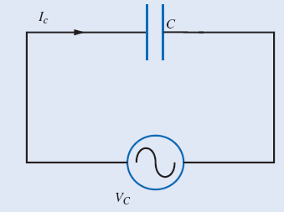
Maxwell’s equations
Displacement Current, cont’d
Example 1: Verify that the conduction current in the wire equals to the displacement current between the plates of the parallel plate capacitor in Figure. The voltage source supplies: V_{c} = V₀ sin ωt.
The conduction current in the wire is
The capacitance of a parallel plate capacitor is:
The electric field between the plates:
The displacement flux density is:
Finally:

Slide 20
Maxwell’s equations
Displacement Current, cont’d
Example 2: Find the displacement current, the displacement charge density, and the volume charge density associated with the magnetic flux density in a vacuum:
There is no conductors, therefore, only the displacement flux exists.
The displacement flux density:
From the Gauss’s law:

Slide 21
Maxwell’s equations
General Forms of Maxwell’s Equations
Differential Integral Remarks
1
Gauss’ Law
Nonexistence of isolated magnetic charge
2
3
Faraday’s Law
4
Ampere’s circuital law
In 1 and 2, S is a closed surface enclosing the volume V
In 2 and 3, L is a closed path that bounds the surface S

Slide 22
Electromagnetic wave equation
Wave equation is a differential equation describes the propagation of electric/magnetic field with distance and time
Starting from Faraday’s law
Taking curl of both sides of latter equation:

Slide 23
Electromagnetic wave equation
General form of wave equation for electric field:
(2.31)
For source-free region → $ρ_{v}=0$:
(2.32)

Slide 24
Electromagnetic wave equation
For free space → $ρ_{v}=0$, $σ=0$, $μ=μ_{0}$, and $ε=ε_{0}$:
(2.33)

Slide 25
Electromagnetic wave equation
Wave equation in time-harmonic fields
For time harmonic variation (phasor representation)
Hence, the wave equation for source-free region can be given by

Slide 26
Electromagnetic wave equation
Propagation constant
(m⁻¹)
Phase shift constant
= wave number
(rad/m)
Attenuation constant
(Neper/m)

Slide 27
Electromagnetic wave equation
Solution of the wave equation
So, we have three equations

Slide 28
Electromagnetic wave equation
For simplicity, we assume that the electric field has one component and the propagation in Z direction
Which is homogenous 2nd order differential equation

Slide 29
Electromagnetic wave equation
Remember:
Similarly

Slide 30
Electromagnetic wave equation
Where
Complex constant
Let θ₁ = θ₂ = 0
Phasor representation
For time domain representation
Forward wave
Backward wave

Slide 31
Electromagnetic wave equation
where
= phase velocity = wave velocity

Slide 32
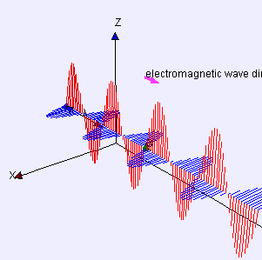
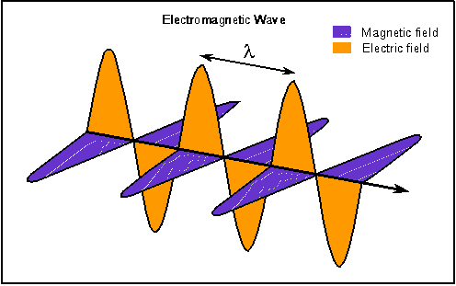
Electromagnetic wave equation
Wave length (λ):
The distance between two points have the same phase or the distance travelled during each cycle.
The wavelength is the distance over which the spatial phase shifts by 2π radians, assuming fixed time

